Slide 1
Windows XP, Linux (Metasploitable) Penetration Test
Matthew Austin & Jesse Wilkins

Slide 2
Stage 1 - Pre-Engagement
In a typical penetration testing work environment, the pentester performs pre-engagement interactions with the client, XYZ, a small start-up company to make sure everyone is on the same page:
Client uses 2 machines Windows XP and Linux (Metasploitable) that will be tested.
Take the time to understand the clients business goals for the penetration test.
Go over any contractual and payment agreements, if applicable.
Know the legal, ethical, contractual limitations.

Slide 3
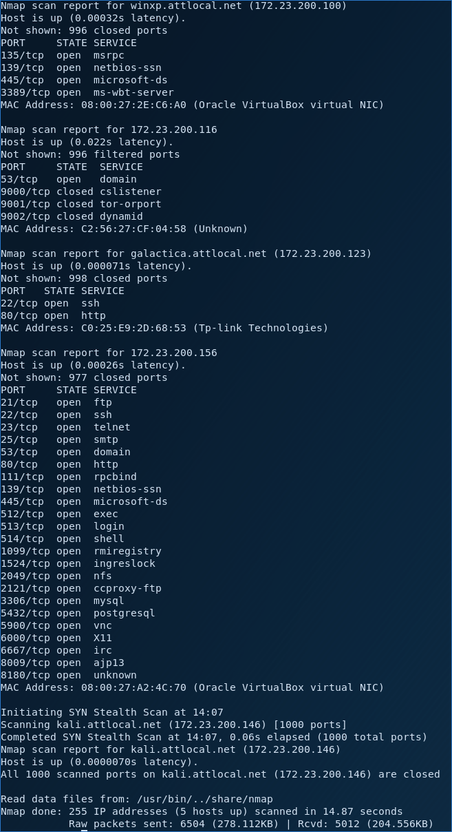
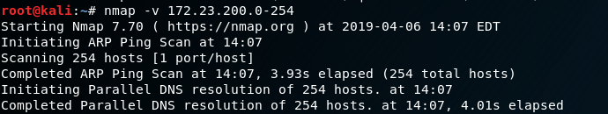
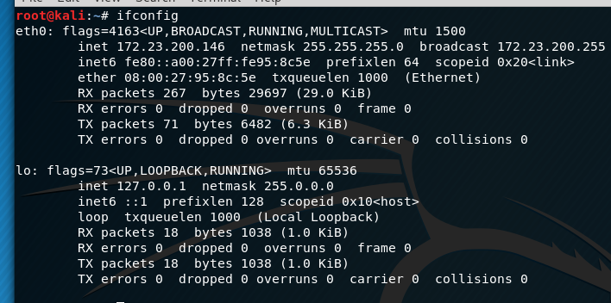
Stage 2 - Information Gathering
Get the IP Address of Linux by using “ifconfig”
NMap scan of both Windows and Linux “nmap -v”
With NMap we can see all of the the opens ports and their services.

Slide 4
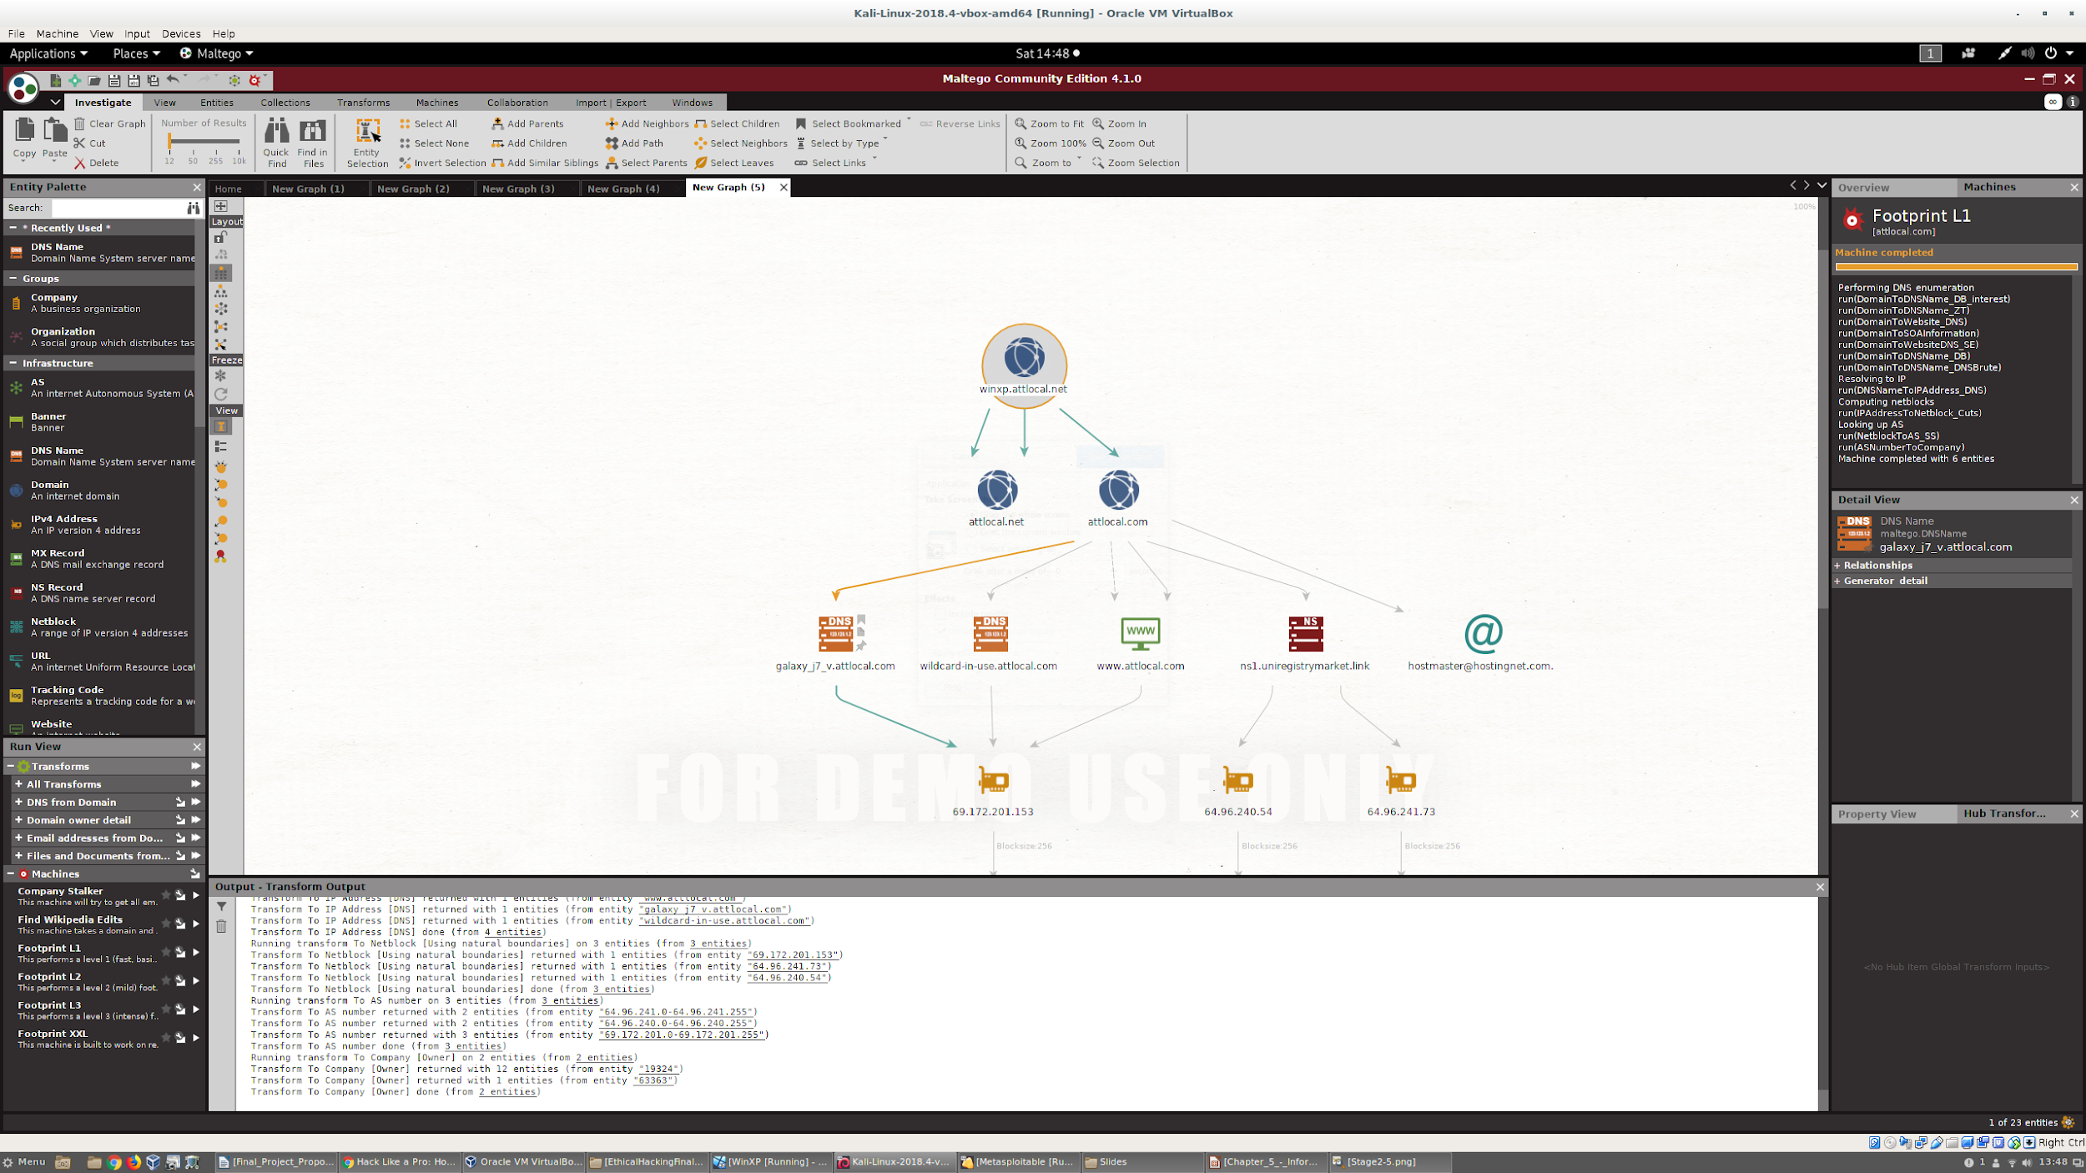
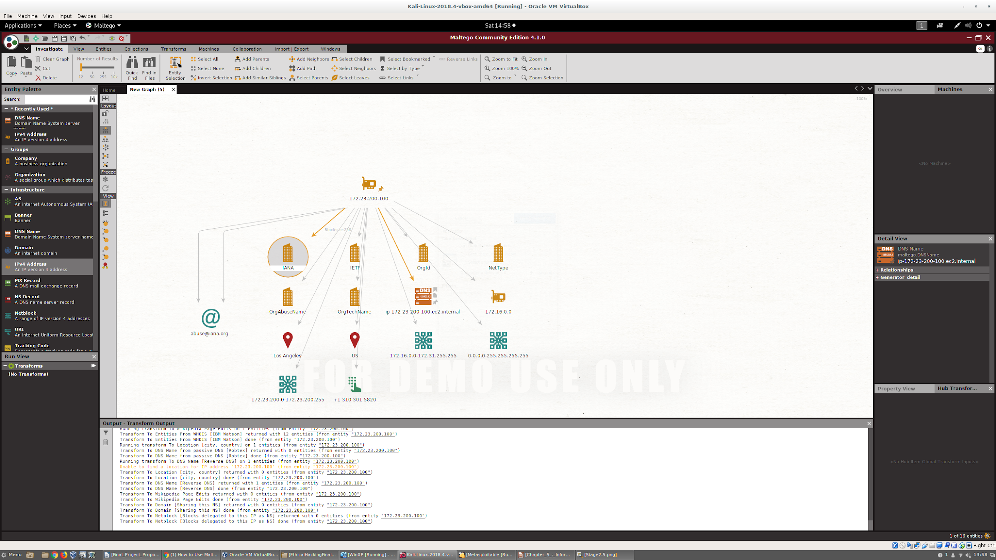
Stage 2 - Information Gathering
Using Maltego an OSINT we gather information such as:
DNS information
Emails
URLs
Phone Numbers
Social Networks
See how they are all connected, therefore revealing vulnerabilities by sending client data over a secure connection using seed servers.

Slide 5
Stage 3 - Threat Modeling
Based on the information gathered using NMAP and Maltego in the Information Gathering Phase we develop a plan to infiltrate the machine.
Get a description of potential threats
Define actions to be taken for those threats
Assess the potential damage of an exploited vulnerability
Find the difficulty level of the exploits
How easy is it to find the exploits?
How many people will be affected?
Prioritize and rate the threats based the the threat level and the client's requests.

Slide 6
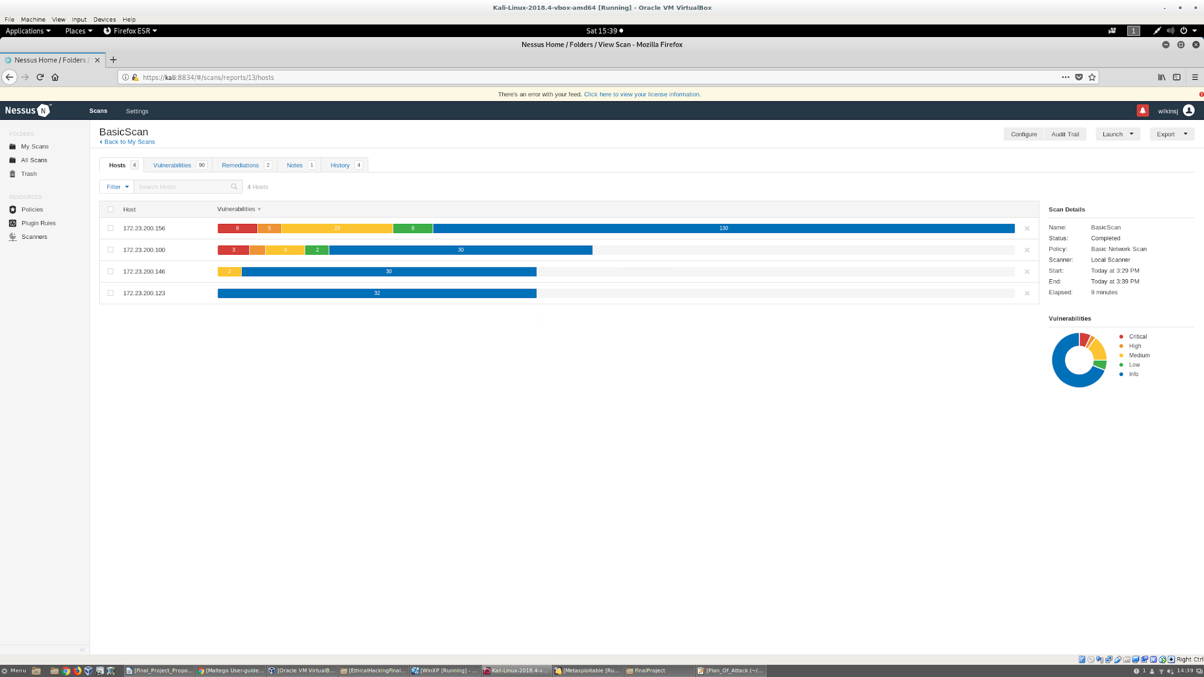
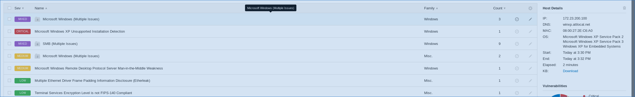
Stage 4 - Vulnerability Analysis
Used Nessus Scanner
Three Critical Exploits in Windows XP
Eight Critical Exploits in Metasploitable
One High-Priority Exploit in Windows XP
Five High-Priority Exploits in Metasploitable
Focus on Critical and High Priority Exploits
Windows:
MS12-010 (Wannacry & ETERNALBLUE Vulnerability)
MS12-020 (Remote Desktop Vulnerability)
Linux:﻿
Bind Shell Backdoor Detection
﻿UnrealIRCd Backdoor Detection
﻿VNC Server 'password' Password

Slide 7
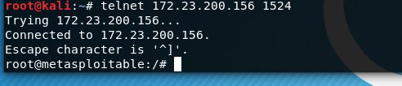
Stage 5 - Exploitation
Simplest Exploit for Metasploitable: ﻿Bind Shell Backdoor Detection Vulnerability
Takes Advantage of Vulnerability in an open shell port
Access Root Without Password!

Slide 8
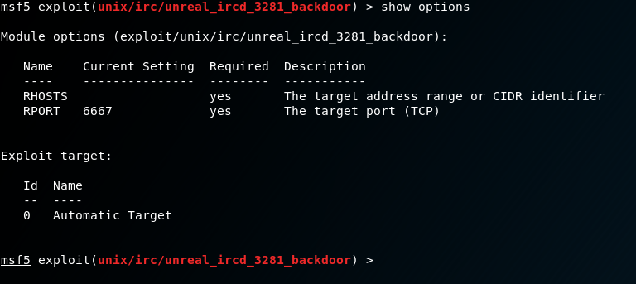
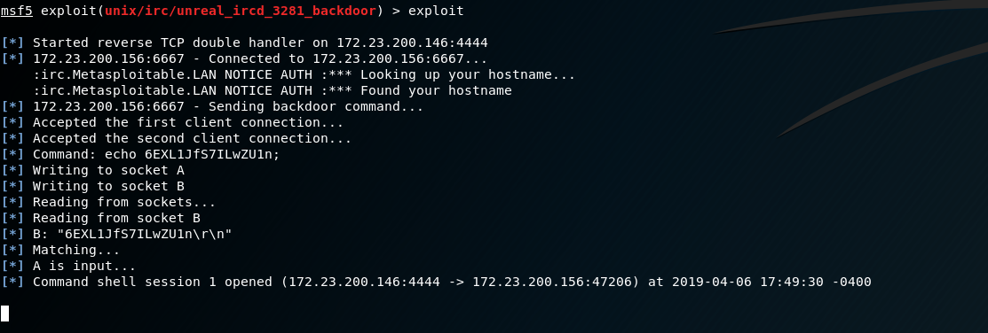
Stage 5 - Exploitation
Exploit Metasploit with module of ircd_3281 backdoor.
Gives a shell session in Metasploitable after giving a remote host IP address and exploiting.

Slide 9
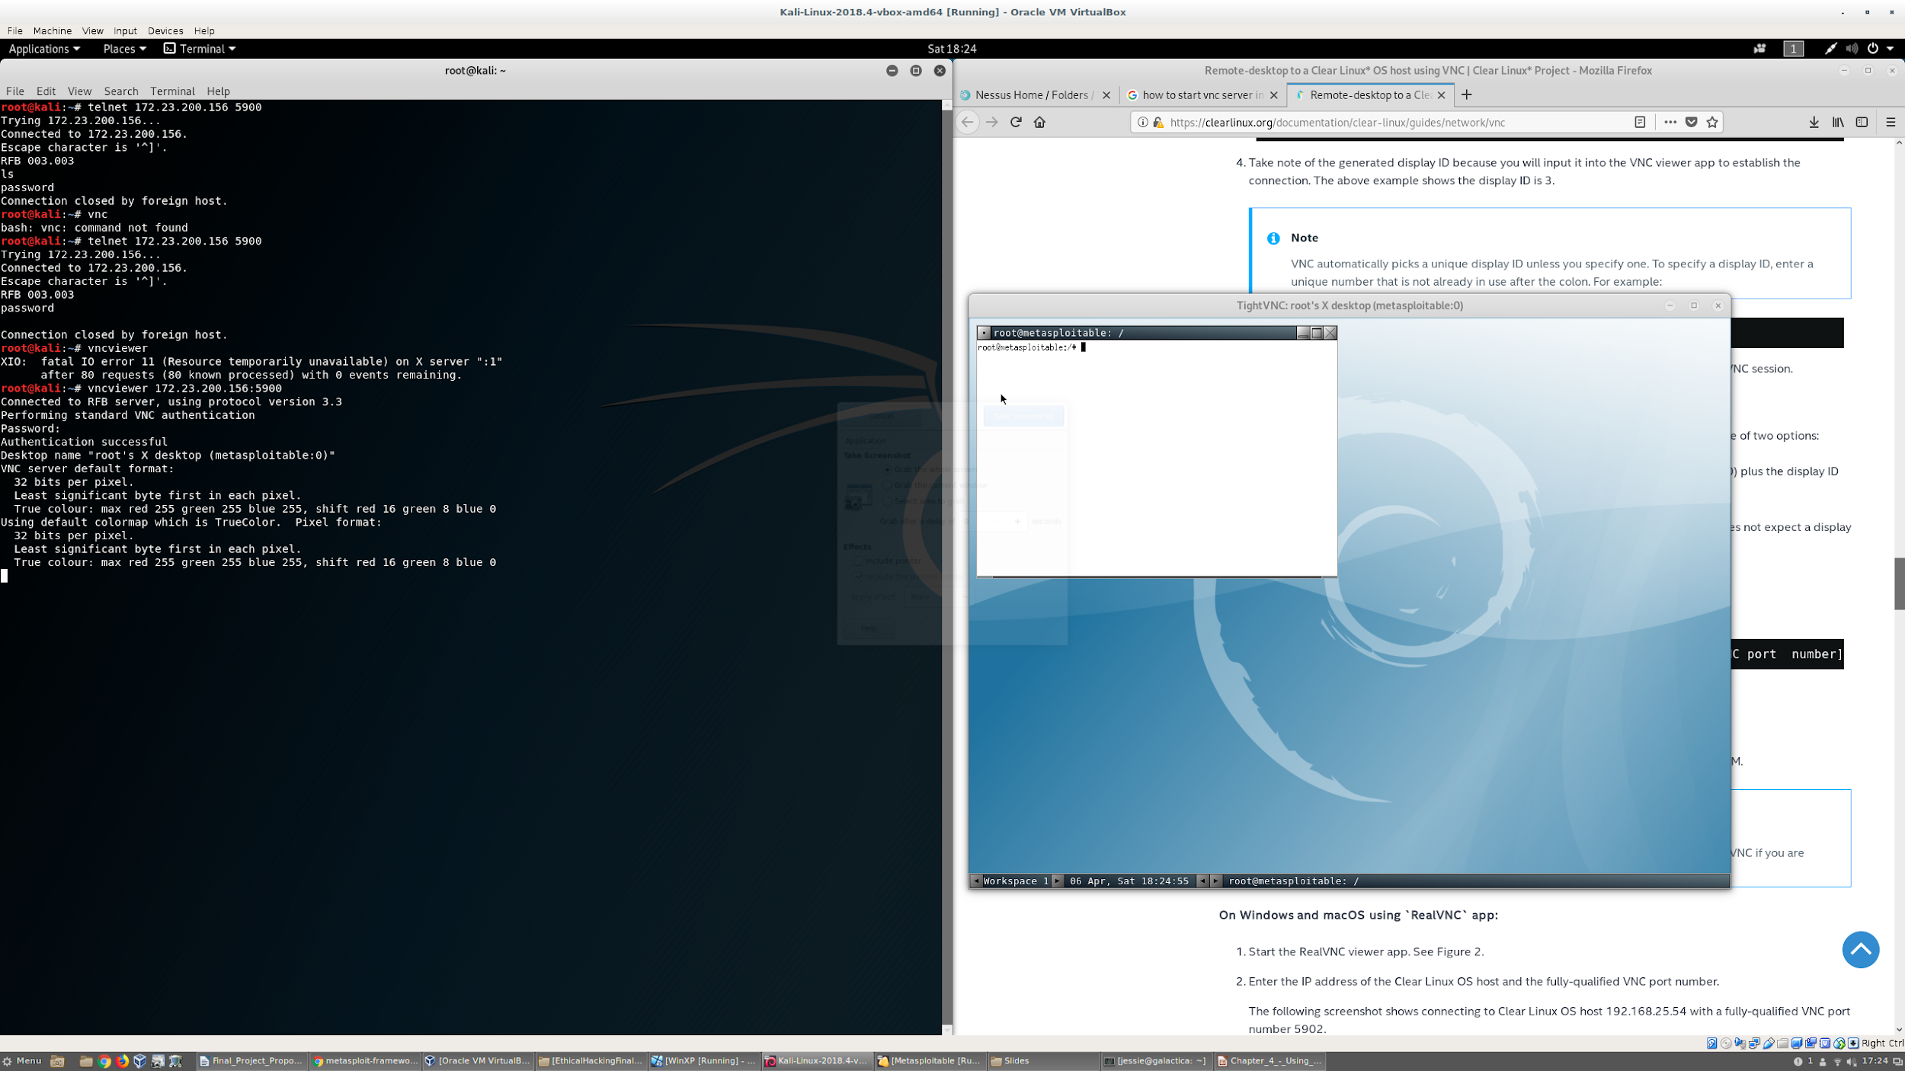
Stage 5 - Exploitation
Take advantage of Linux VNC Viewer’s weak password.
Simply connect to Metasploitable ip address and port via vncviewer
Enter password as ‘password’
Gives access to root

Slide 10
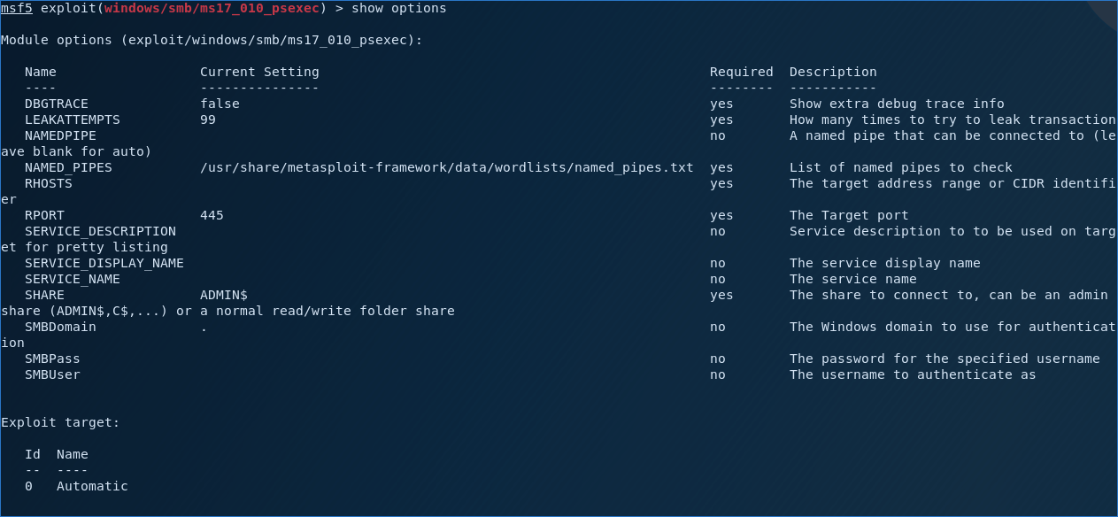
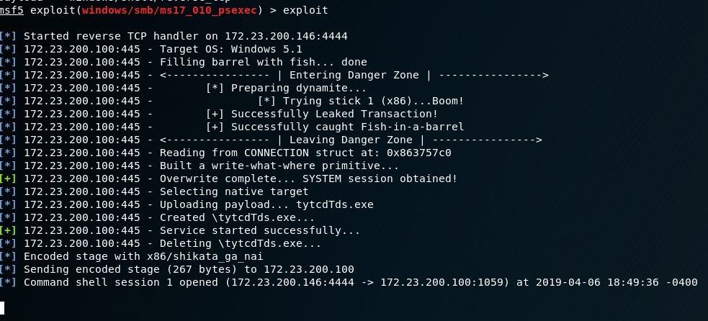
Stage 5 - Exploitation
Windows exploit MS17-010: The Wannacry vulnerability
Uses reverse tcp vulnerability
Set the the remote host, local host, payload for shell, and then exploit.
Gives shell that access to Windows file system

Slide 11
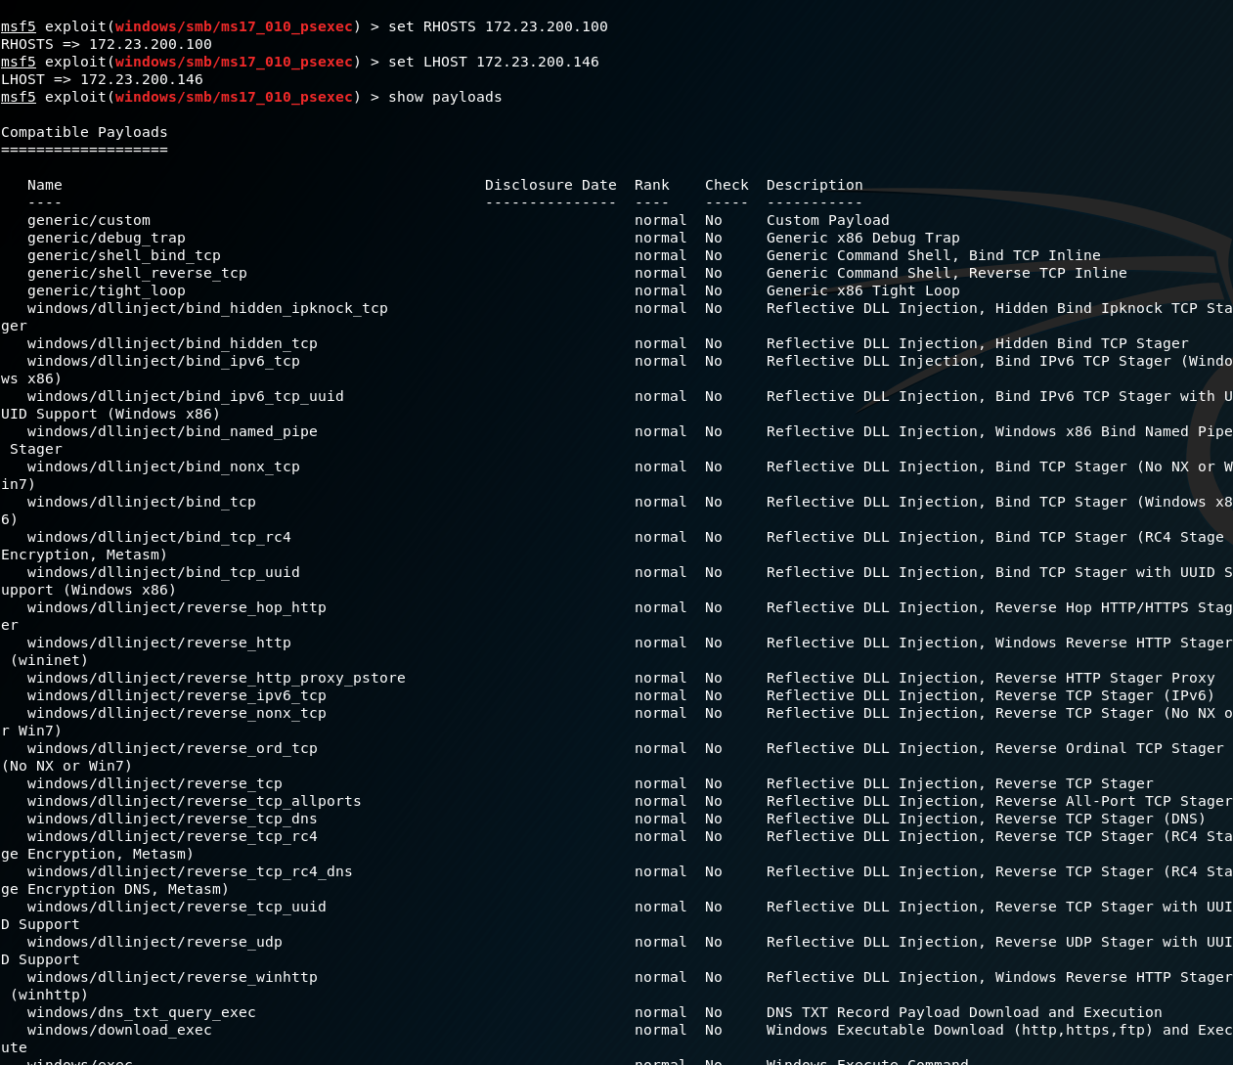
Stage 5 - Exploitation
Setting up the reverse-tcp payload.
Adding the IP address of the target for the attack (RHOST)
Binding the listening port to Linux the attacker (LHOST)

Slide 12
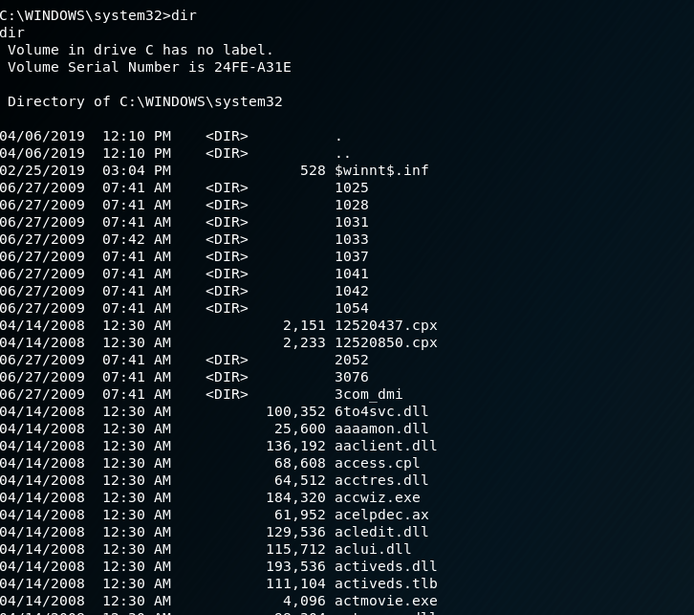
Stage 5 - Exploitation
Shows the targets systems32 directory and its contents from exploit

Slide 13
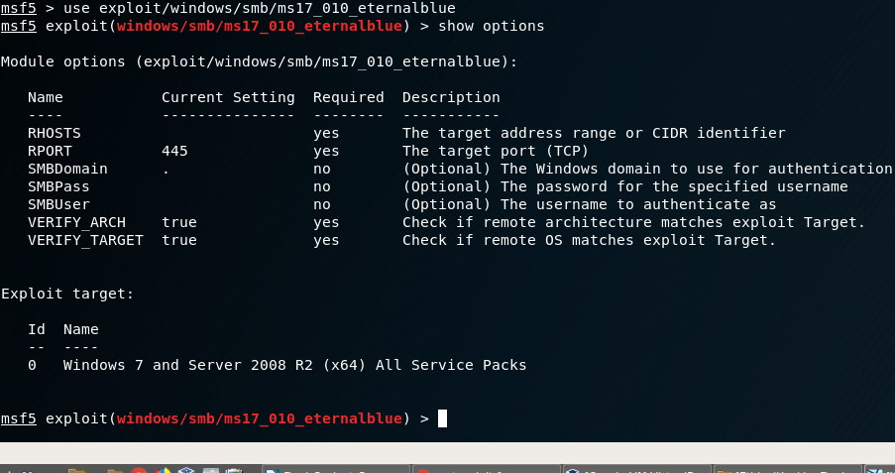
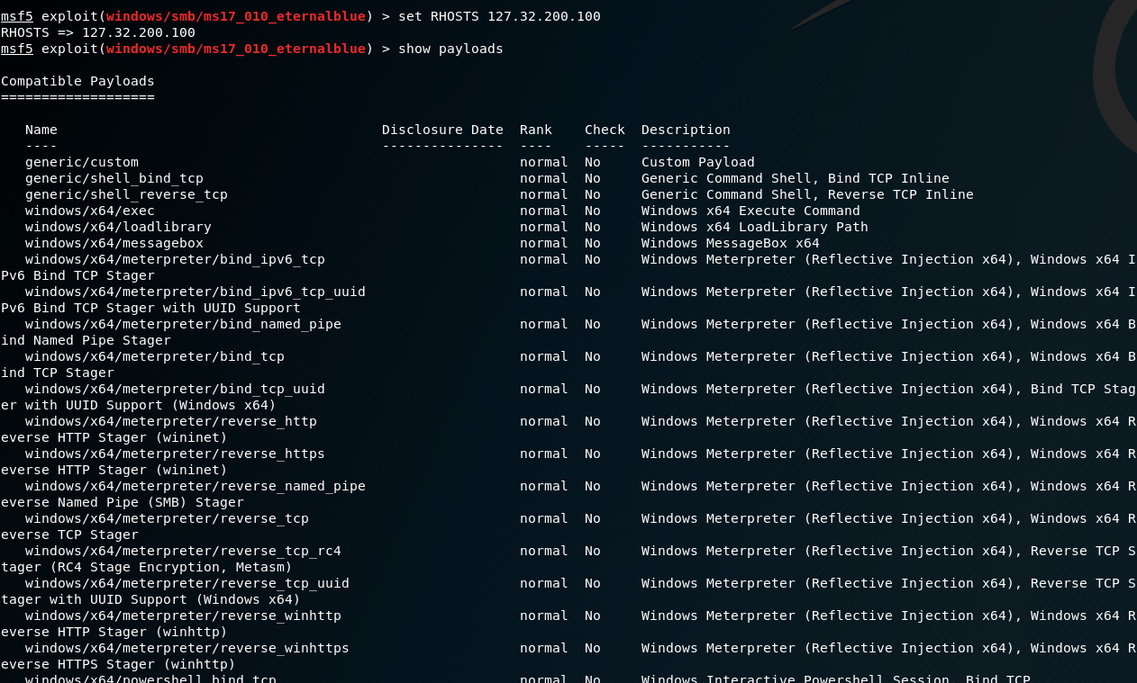
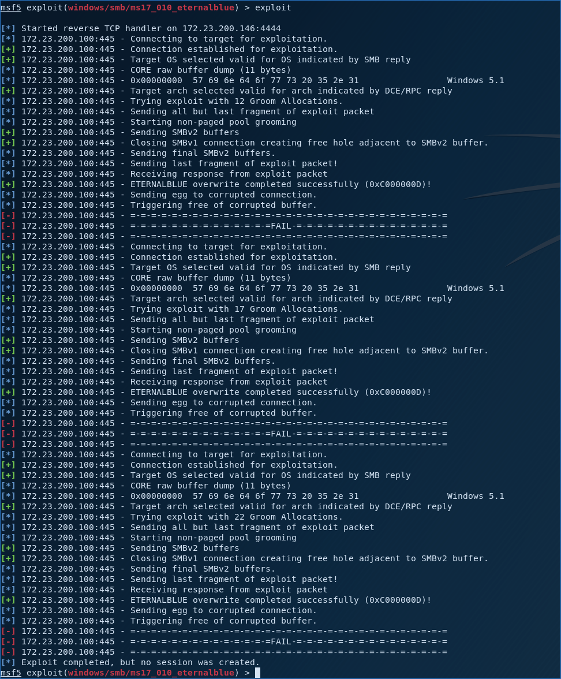
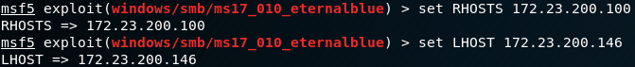
Stage 5 - Exploitation
This is one of the eternal blue exploits we tried.
It failed for some reason.

Slide 14
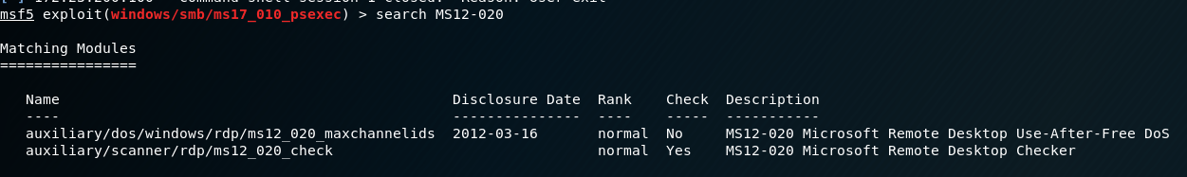
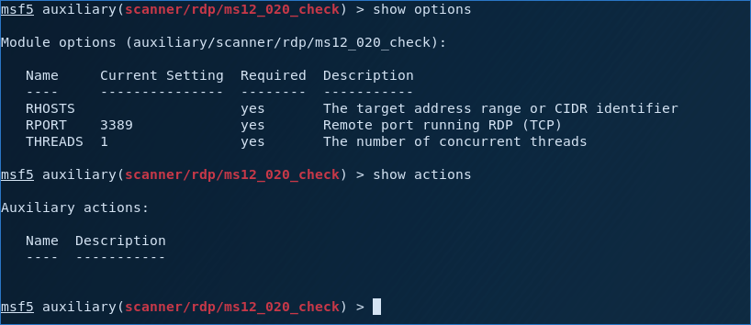
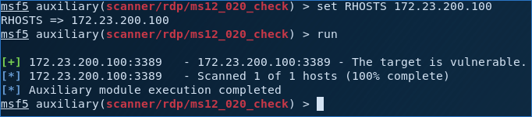
Stage 5 - Exploitation
Auxiliary that scans/checks if vulnerability can be successful
Searching for the MS12-020 module within Metasploit
MS12-020 is a Remote Desktop Denial of Service (DOS) exploit
Setting up to attack the target ip address
The check was successful showing the target ip address is vulnerable

Slide 15
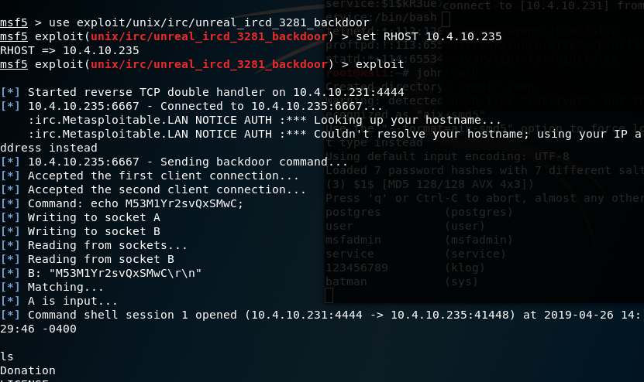
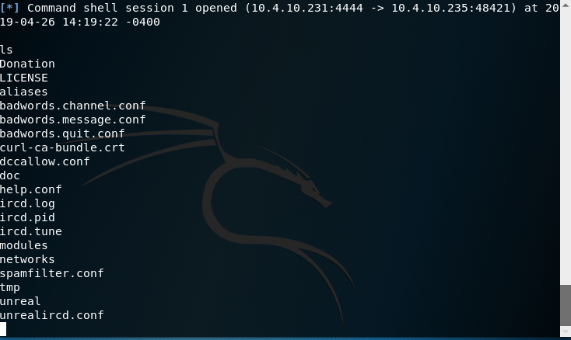
Stage 6 - Post-Exploitation
Ifconfig on Kali & Metasploitable to get IP’s
Used the irc exploit to get back into Metasploitable

Slide 16
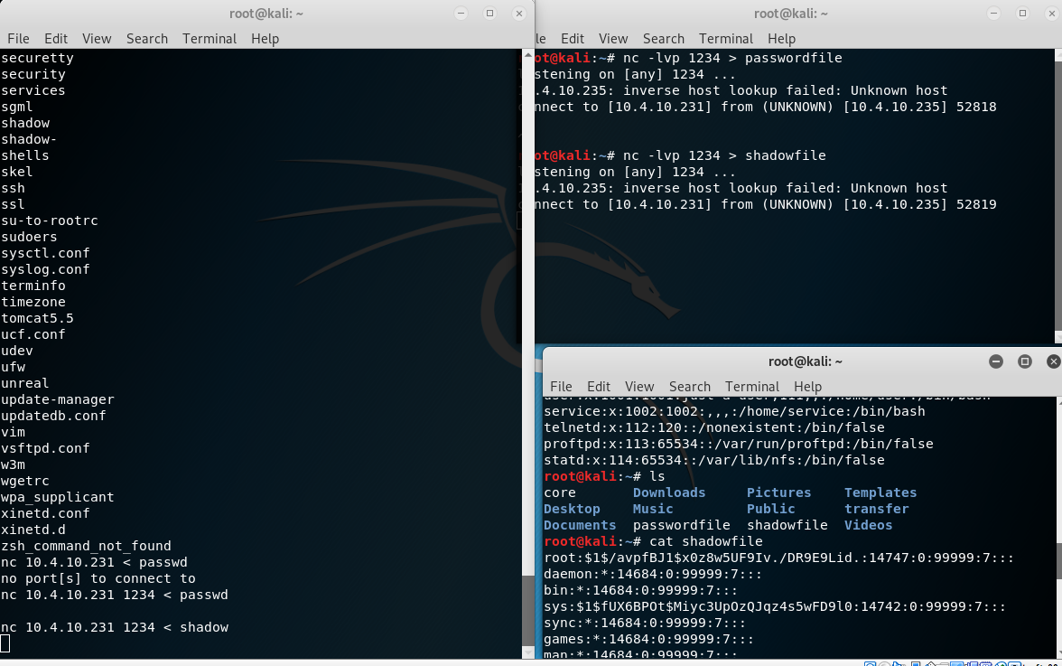
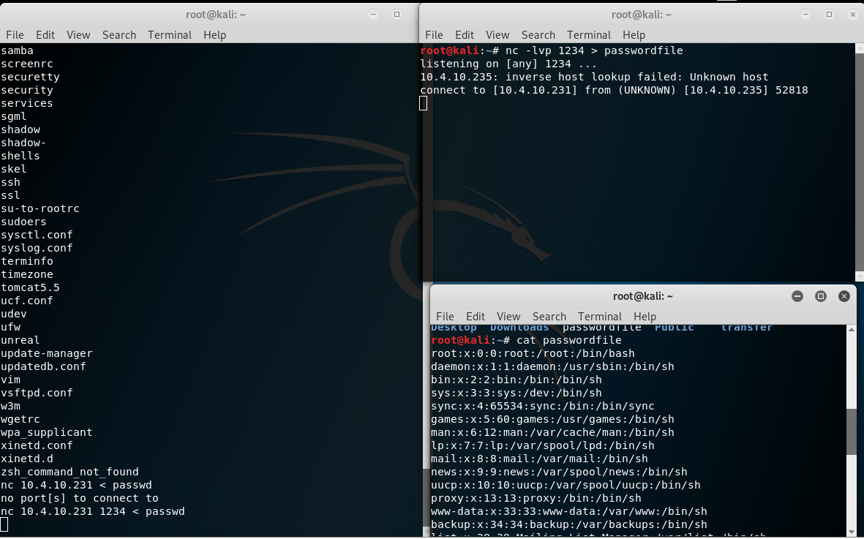
Stage 6 - Post-Exploitation
Used netcat to listen on port 1234
Sent passwd and shadow files from Metasploitable via netcat

Slide 17
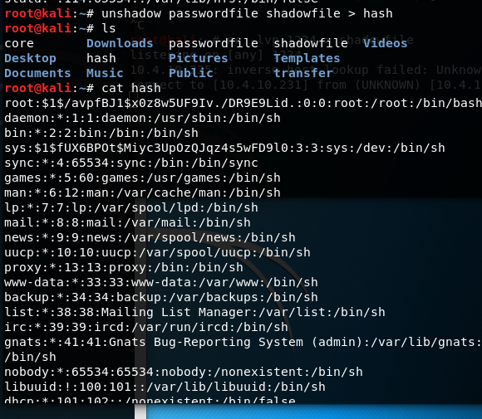
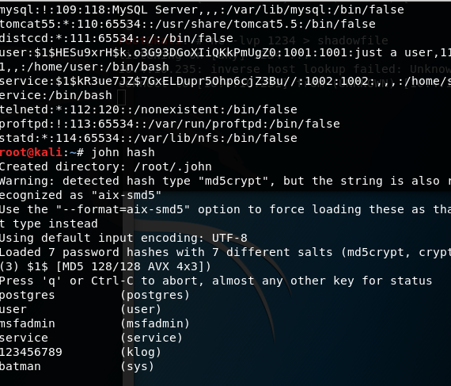
Stage 6 - Post-Exploitation
Unshadowed password file with shadow file
Stored in hash file
Used john the ripper to get passwords

Slide 18
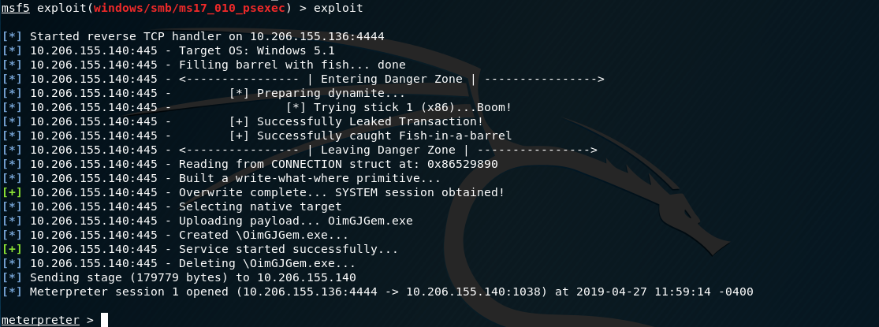
Stage 6 - Post-Exploitation
Window XP Post-Exploitation
Used Eternal Blue Exploit with Meterpreter Payload
Able to get into system with meterpreter session

Slide 19
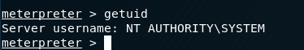
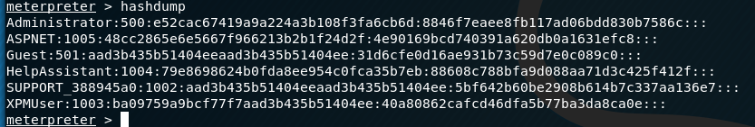
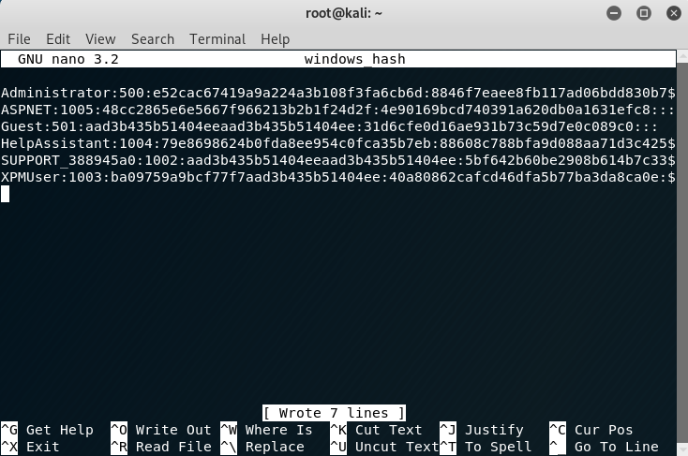
Stage 6 - Post-Exploitation
Check Out Current Windows UID
Dump Hashes
Place Hashes in Kali Linux File called ‘windows_hash’

Slide 20
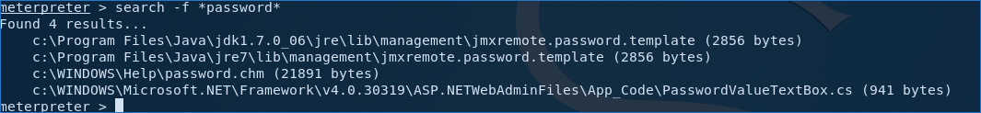
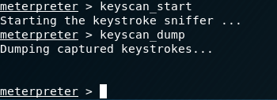
Stage 6 - Post-Exploitation
Search for Files with ‘password’ in name
Set Key Logger

Slide 21
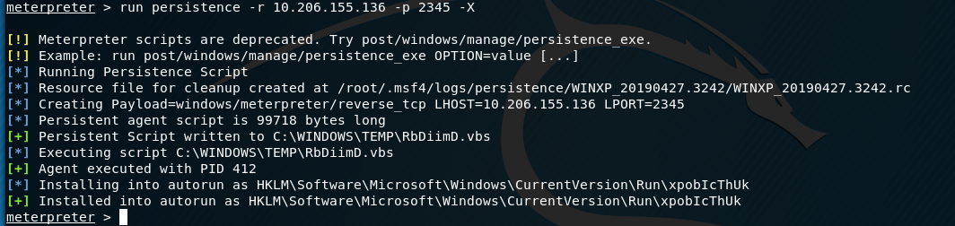
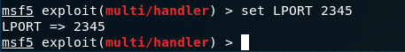
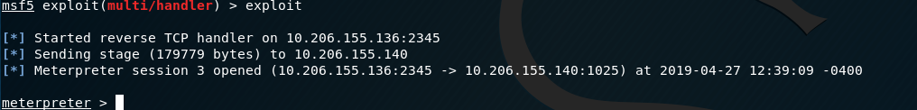
Stage 6 - Post-Exploitation
Leave Backdoor in Windows XP with run persistence
Set Multi-Handler to the correct port and exploit
Gets session when Windows XP is running

Slide 22
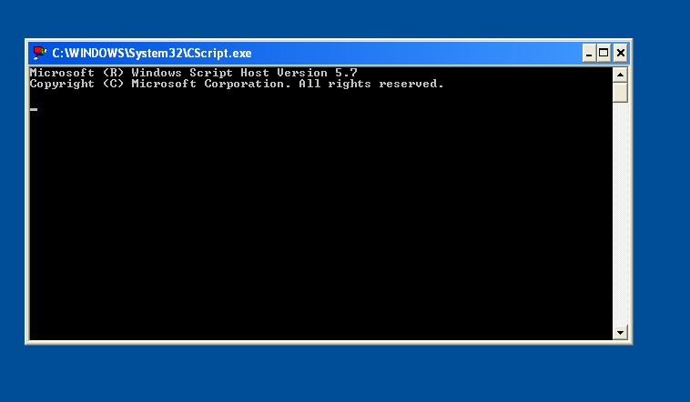
Stage 6 - Post-Exploitation
Windows Shell that Opens When Backdoor is running
Closing the Window does not end back door script

Slide 23
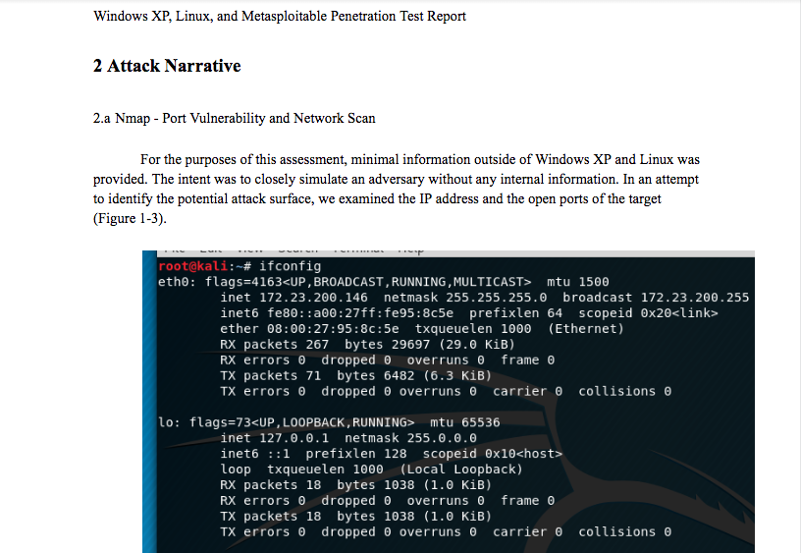
Stage 7 - Reporting
Full Report with…
Executive Summary
Technical Details
Lots of Screenshots
Recommendations
Plus other details

Slide 24
Recommendations
Update the Linux and Windows XP Systems (Possibly abandon both OS’s)
Turn on Firewalls and close unnecessary ports
Delete outdated and vulnerable software

Slide 25
Challenges
Post-Exploitation on Linux had to be Done by Hand
Network Issues Made Process More Difficult

Slide 26
Questions?

